Slide 1
EPSY 220 Career Theory and Practice Section I
Tuesdays & Thursdays
4:00 pm-6:50 pm, Wohlers 236
INSTRUCTOR: Matt King
Office Hours: by appointment

Slide 2

Welcome!

Slide 3
Free Writing
On a sheet of paper or word doc – you won’t turn this in – respond to the prompt
You will have 90 seconds per prompt: keep writing for the whole 90 seconds
Just write what comes to mind and try not to filter it

Slide 4
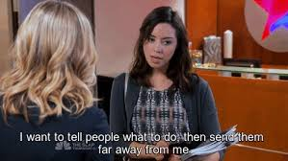
What do you want to do after college? Why? When did you decide this?

Slide 5

What do you value? Generally? In your future career? (e.g., money, family, leisure, location, etc.)

Slide 6

What are your personal strengths? What makes you uniquely you?

Slide 7
Introductions

Slide 8
Who wants to go into . . .
Medicine
Law
Engineering
Finance/Business
Social Services/Public Services/Helping Professions
Politics
Communication/Advertising
Art/Design
Education
IT/Computer Sciences
Other?
I HAVE NO IDEA!
Notes:
So you can see you have some people in this class with similar interests. You’ll want to work with one another, answer eachother’s questions – you have resources in this class!

Slide 9
One You Index Card
Name (phonetic pronunciation)
Year
Major
What you’re doing after this class (e.g., internship, job, classes/another year of school, traveling, just chillin’ etc.)
What are your ultimate career goals?
What do you hope to get out of this class?

Slide 10
Major Course Goals
Learn about yourself
Learn about careers, grad school, and majors
Prepare for the transition to the world of work
Notes:
Course is broken into 3 parts: theory, application, skills

Slide 11
Additional Course Goals
Increase self-awareness
Understand how social & environmental factors impact your career and the working world
Develop an understanding of the theories underlying career development
Acquire basic career skills, including résumé writing, interviewing, and job searching

Slide 12
Course Materials
Text: No textbook required
Other Readings/Class Resources: COMPASS course website: https://compass2g.illinois.edu; Login using your NETID and NETID password
In-Class Inventories…
E.g., the Strong Interest Inventory

Slide 13
Course Requirements
Attendance & participation
Exams: midterm and final
Current Events
Projects

Slide 14
Be in Communication with Me
Personal problems happen. Trust me, I get it. If you’re having trouble or something important is happening in your personal life, contact me EARLY and keep me updated.
Plan ahead with your communication: I can’t guarantee that I’ll check e-mail after 11:00 p.m. the night before a test or project is due.
That said, I’m usually very good with responding to emails within 24-hours, if not much, much quicker. You have my cell number too. You can text or call.

Slide 15
How Office Hours Work…
I prefer to meet for coffee or food on campus than in some office
Rather than having a regular office hour, e-mail me and we’ll find a time to meet
I’m available to meet about the class and about careers, grad/prof school, picking a major, internships, life, etc.
I actually took this class during the semester I was applying to graduate school here. So, I know a thing or two about:
This course
This campus
Campus resources, useful classes, etc.
Graduate school (especially Counseling Psychology)
Finding jobs, internships, etc.

Slide 16
IMPORTANT Course Policies
Attendance - NO UNEXCUSED ABSENCES; For each unexcused absence, deduct 10 pts
Lateness - deduct 5 points per class if it’s an ongoing problem
Participation – worth 110 POINTS! Evaluated largely by how much you participate in class discussions
Come prepared to class with paper and a writing utensil. I will generally assign a writing assignment that will be completed and collected during class (part of your participation grade)
Late Assignments – ONLY in case of emergency, & with sufficient documentation
Make-Up Exams - ONLY in case of emergency, & with sufficient documentation

Slide 17
Other Policies…
No incompletes will be offered
ADA -- If you have any accommodations, please notify me
I’m associated with DRES and can help you learn about services if necessary
Students are expected to conform to the University of Illinois Code of Conduct for all Students
I will post class PowerPoints, the syllabus, project guidelines, and grades on Compass2g
If you see me on my email, I’m fair game to chat with (virtual office hours!)

Slide 18
REMEMBER…
Cell phones, texting, g-chatting, checking Facebook, checking e-mail…
If I catch you doing it in class, you’ll lose your participation points for the day
The idea isn’t to be super mean (I’m guilty of doing these things too- since I began working on this powerpoint, I’ve picked my tournament bracket and Googled “how many episodes are in season 3 of Black Mirror”) but rather to get you in the pattern of “appropriate” workplace behavior…
Oh yeah, this class is all about preparing you for the world of work- BE PROFESISONAL in your demeanor, assignments, communication, etc.
Extra Credit: you can earn points by going to workshops at the Career Center (or other approved career-related events; see me or your syllabus for details)

Slide 19
Projects
Format/Style:
12-point Times New Roman or Arial font; 1-inch margins
Use formatting that is common in your field (e.g., APA, MLA, etc.)
Double space all papers EXCEPT for your résumé and cover letter (NEVER EVER DOUBLE SPACE THOSE)
Type ALL of your assignments unless given express permission to do otherwise
Submit on compass (or email if necessary)
Due before class

Slide 20
Projects…
Grading Criteria:
Completeness
Depth of thinking/analysis
Integration of course concepts
No surprises- you get to see the grading rubric before a given assignment is due

Slide 21
Projects (most are short!!)
Career Autobiography
Major/Grad School/Internship Exploration
Career Exploration
Résumé & Cover Letter (Rough & Final)
Current Event
Informational Interview (Parts I & II)
Group Discussion Facilitation

Slide 22
Strategy & Planning…
Number of points assigned to each assignment is detailed in the syllabus
Due dates for the assignments are in syllabus; reminders given in class & via e-mail
General guidelines for assignments are in the syllabus; specific guidelines distributed closer to due date (keep an eye on Compass)

Slide 23
How to do well in this class
Come to class and participate
Seriously, this could be one of the most useful classes of your academic career if you want it to be. Where else will you get detailed feedback on your resume, interviewing skills, and maybe even deciding on a career?
Carefully follow instructions for the projects and turn them in on time
Ask questions and take notes in class when needed
Complete the extra credit
Be attentive, involved, & respectful

Slide 24
Activity I: Introductions
Split into pairs
Find out
Name
Year in school? Major?
Where are you from?
What did you want to be as a kid? Has it changed since then? Any plans for your future career?
What is your favorite movie, TV show, or band/artist?
Then, you’ll introduce yourself to the class
Be sure to mention the above or anything you want to share, and also why you chose to take this class

Slide 25

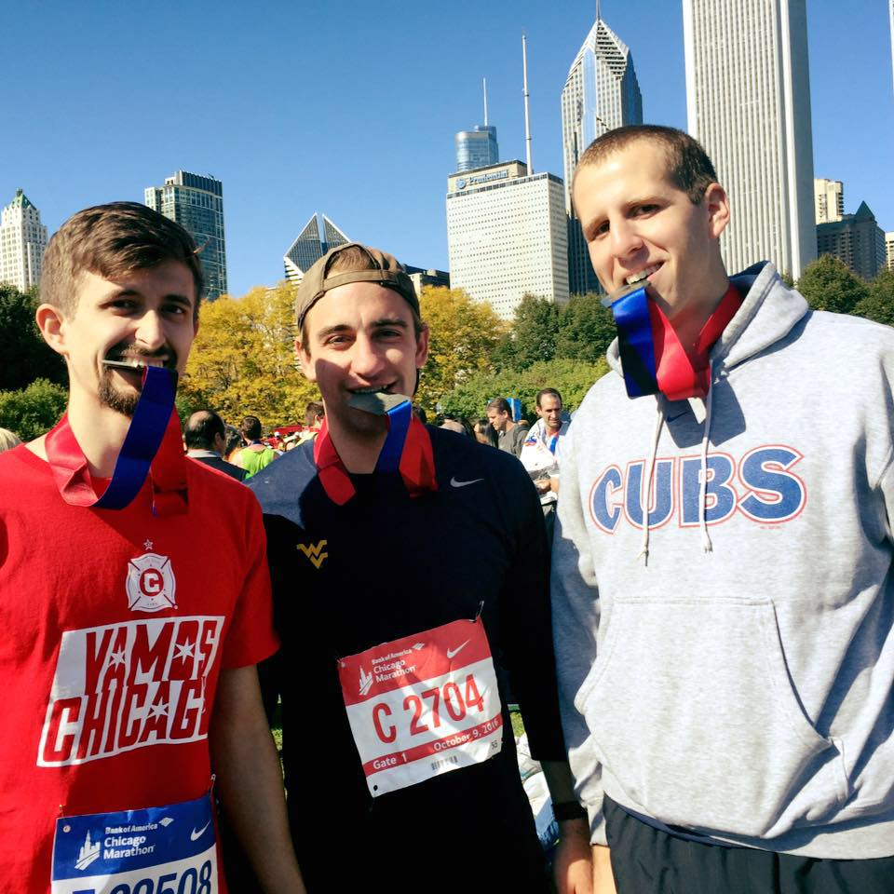
Your Instructor
Name: Matt
Year/Major: 3rd year doctoral student, Counseling Psychology
Home Town: New Lenox, IL . . . but Champaign is my home now
Movie(s): Ferris Buehler’s Day Off, Lord of the Rings, & Shutter Island
TV Show(s): The Office, Parks and Rec, & Arrested Development
Band/Artist: Dave Matthews Band
As a kid, I had no doubt I would play professional baseball. Then, I realized how exceptionally average I was at baseball and realized I should probably pursue something else. I started at a different university before transferring here and even changed my major. I was planning to be an MD. Then, I applied to 4 different types of graduate school programs, and here I am, soon to be a psychologist.
Seriously, you don’t have to have it all figured out! But, I’m here to help you with that.

Slide 26
LET’S TAKE A BREAK!

Slide 27
Tips
Seems intense but most assignments are short, easy…worthwhile!
Put time into it and you will benefit
Don’t wait until the last minute
I’m a helpful resource – don’t be intimidated!!

Slide 28
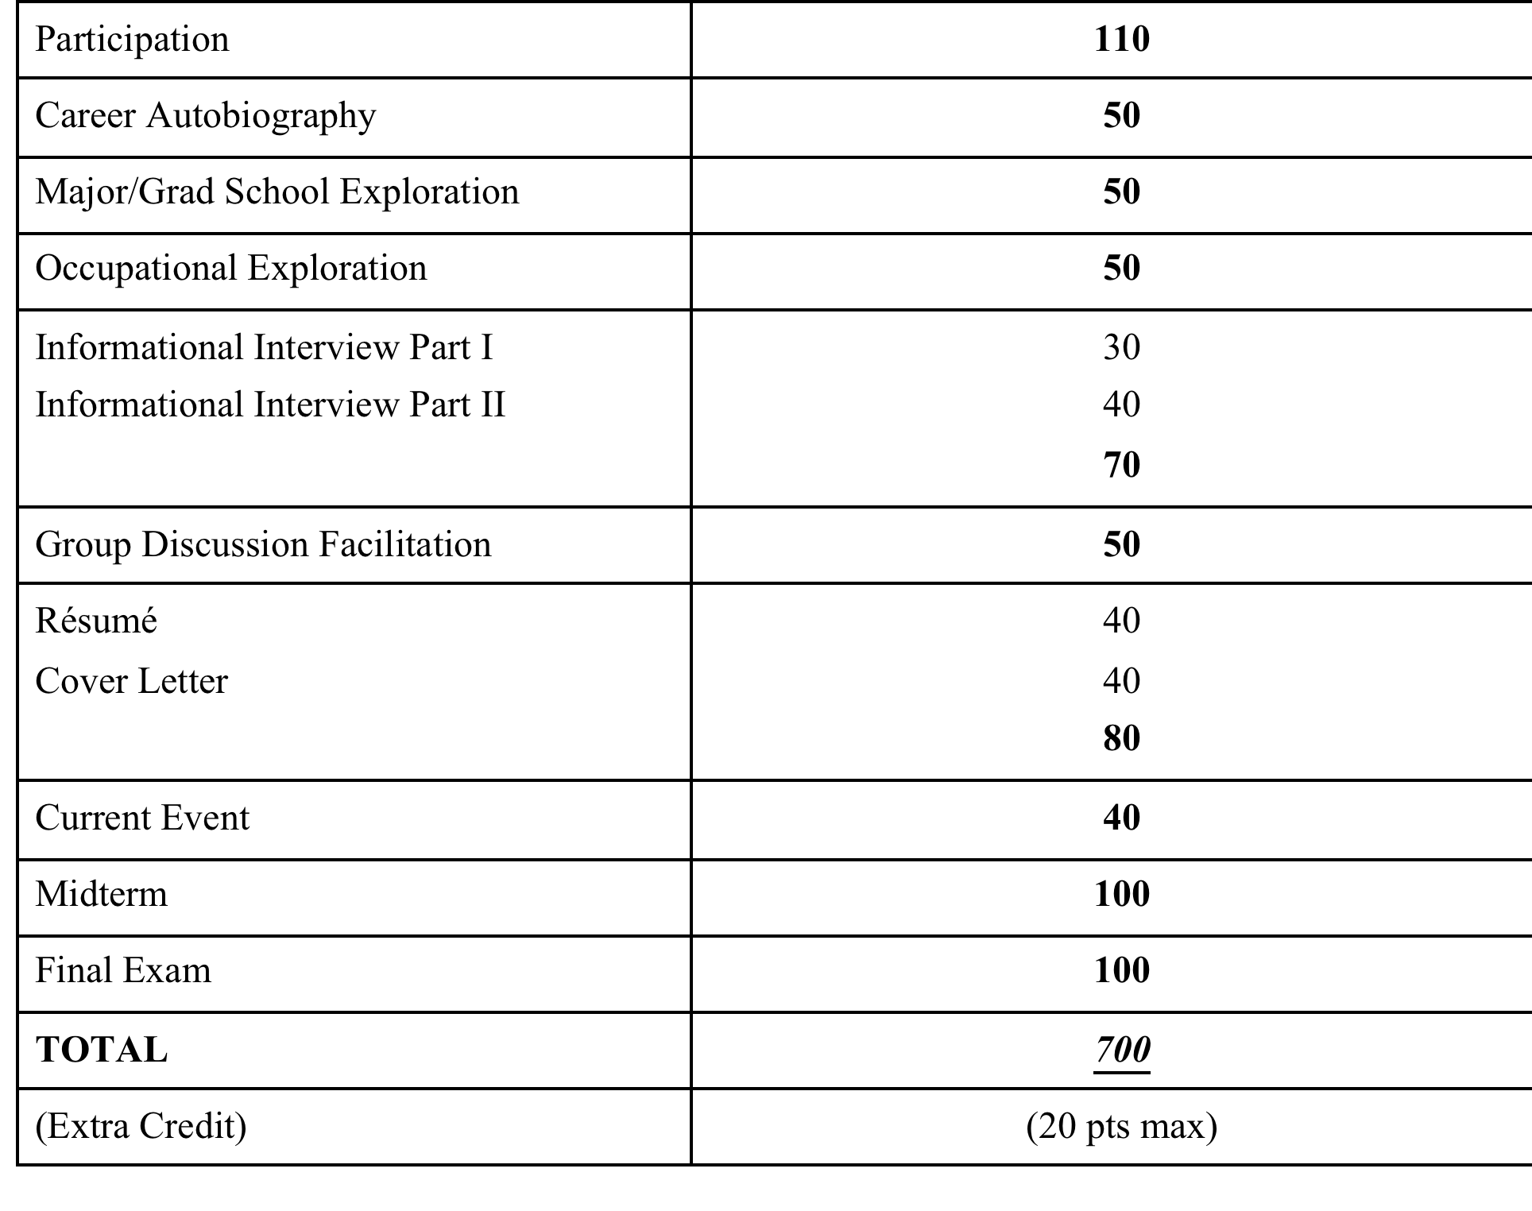

Slide 29
Grading Policy
The number of points you accumulate out of 700 possible will determine Grades:
651-700 points = A 93+%
630-650 points = A- 90-92%
609-629 points = B+ 87-89%
581-608 points = B 80-86%
539-559 points = C+ 77-79%
511-538 points = C 70-76%
469-489 points = D+ 67-69%
441-468 points = D 60-66%

Slide 30
Activity II: End of the World
Break it into groups of 3 3-4
Description:
By the end of the tomorrow, a bizarre virus will kill all of humankind. However, you are a brilliant scientist who has manufactured a vaccine that can make people completely immune to the effects of the virus. Unfortunately, you only have enough vaccine to inoculate 5 people, and you only have 14 people from which to choose. Which of the following people will you vaccinate in order to continue our species from this horrible event?

Slide 31
Activity III: End of the World
A physician (65 yrs, woman)
An airplane pilot (60 yrs, man)
A professional musician (26 yrs, man)
A librarian (23 yrs, woman)
A politician (30 yrs, man)
A construction worker (40 yrs, man)
A computer programmer (38 yrs, woman)
A teacher (49 yrs, woman)
A judge (45 yrs, woman)
A biologist (32 yrs, woman)
A psychiatrist (34 yrs, woman)
A farmer (57 yrs, man)
A minister (36 yrs, woman)
A policeman (50 yrs, man)

Slide 32
Activity III: End of the World
What does this activity tell you?
Your values
How you think about various occupations
Your thoughts about age and gender
More…

Slide 33
Final Thoughts
NOTE: We will do a tour of the Career Center (soon after Spring Break)
What are you hoping to get out of this class?
What would you like to learn more about that isn’t listed?
How do you want to schedule breaks into this class?
We won’t always (or regularly go the entire 2:50, but plan as if we will)

